Slide 1
Principles of Database Systems (CS307) Lecture 7: More about NULL; Ordering; Window Function; Function
Ran Cheng
Department of Computer Science and Engineering
Southern University of Science and Technology
Most contents are from slides made by Stéphane Faroult and the authors of Database System Concepts (7th Edition).
Their original slides have been modified to adapt to the schedule of CS307 at SUSTech.
Notes:
In this chapter, I will introduce how to retrieve data from one table. Just from one table. I will introduce how to retrieve data from multiple table in next chapter.

Slide 2
More about NULL

Slide 3
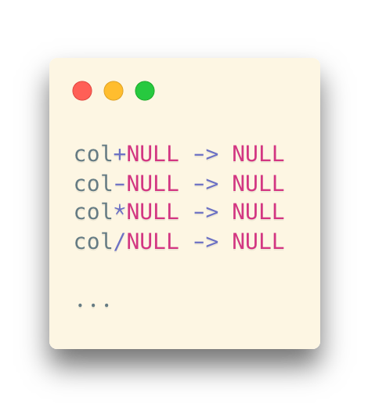
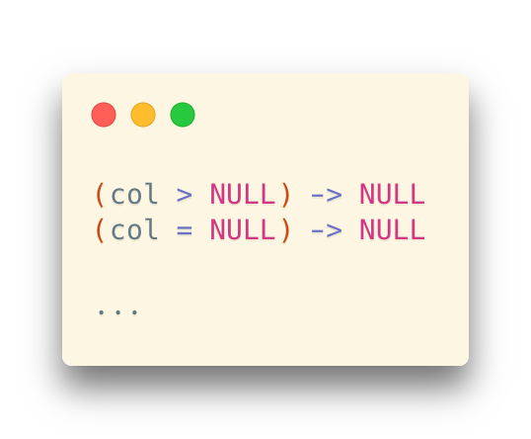
Expressions with NULL Values
Most expressions with NULL will be evaluated into NULL
Arithmetic operations:
Comparison operations:

Slide 4
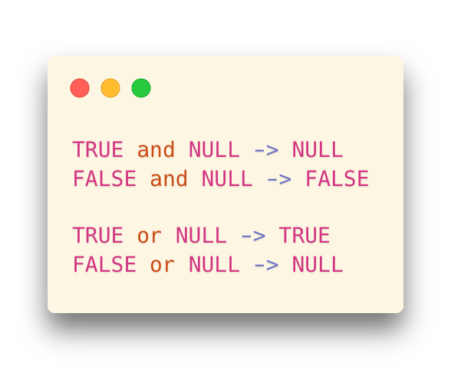
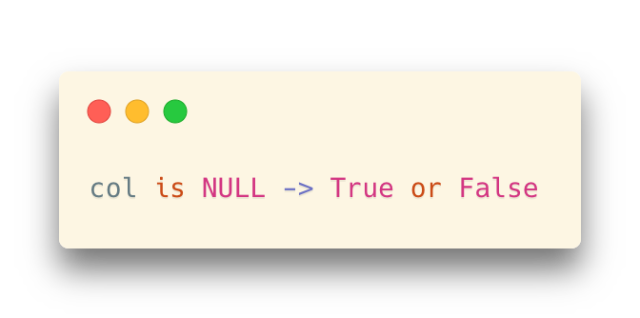
Expressions with NULL Values
Most expressions with NULL will be evaluated into NULL
But, there are some conditions where the values are not NULL
Logical operators (or, and):
Three-valued logic (true, false, and unknown)
More on this: Three-valued logic and its application in SQL
https://en.wikipedia.org/wiki/Three-valued_logic#SQL
The way we use to check a NULL value: use is, not =

Slide 5
Recall: Subquery after Where
Some important points for in()
in() means an implicit distinct in the subquery
in(‘cn’, ‘us’, ‘cn’, ‘us’, ‘us’) is equal to in(‘cn’, ‘us’)
null values in in()
Be extremely cautious if you are using not in(…) with a null value in it
value not in(2, 3, null)
not (value=2 or value=3 or value=null)
value<>2 and value<>3 and value<>null
always false or null, never true
If value is 2, the result is:
FALSE and TRUE and NULL -> FALSE
if value is 5, the result is:
TRUE and TRUE and NULL -> NULL
if value is NULL, the result is : NULL and NULL and NULL -> NULL

Slide 6
Ordering

Slide 7
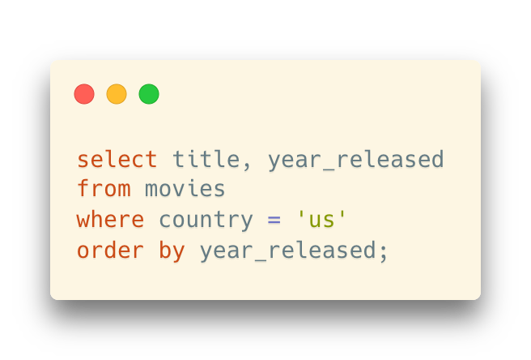
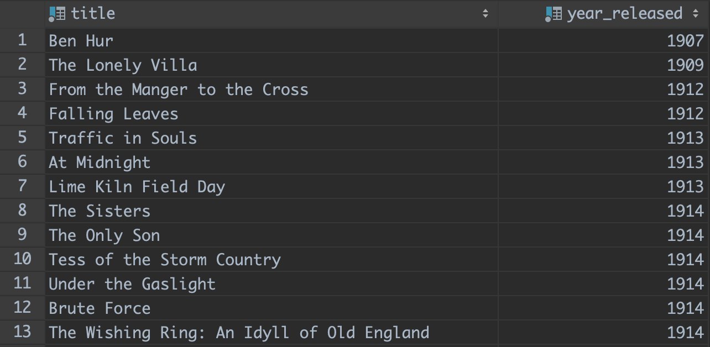
Ordering in SQL
order by
A simple expression in SQL to order a result set
It comes at the end of a query
... and, you can have it in subqueries, definitely
Followed by the list of columns used as sort columns

Slide 8
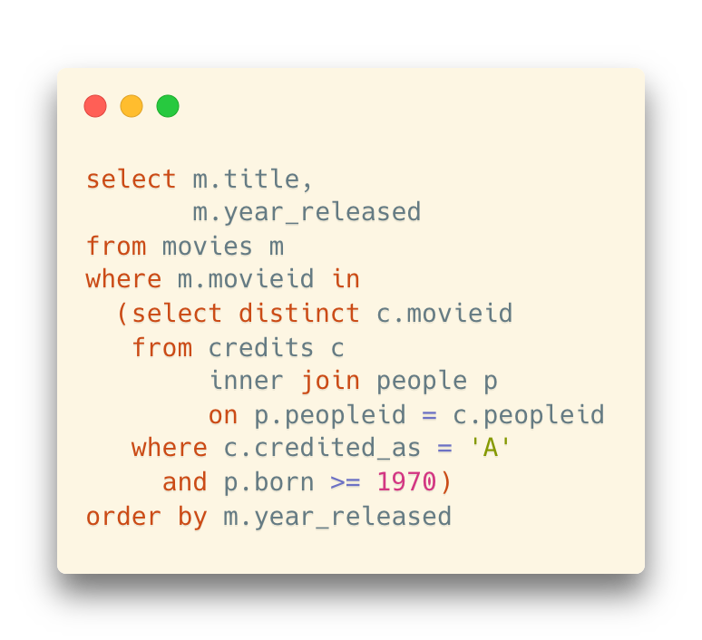
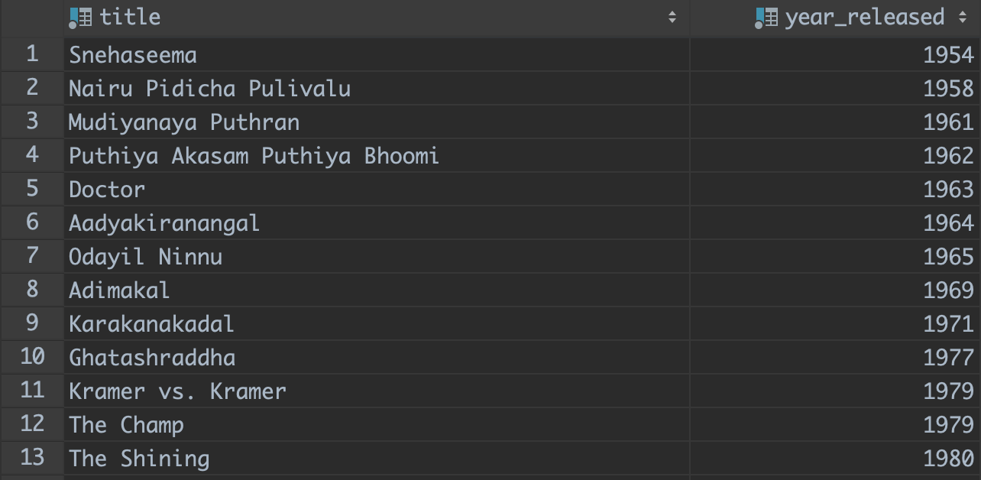
Ordering in SQL
No matter how difficult the query is, you can apply order by to any result set

Slide 9
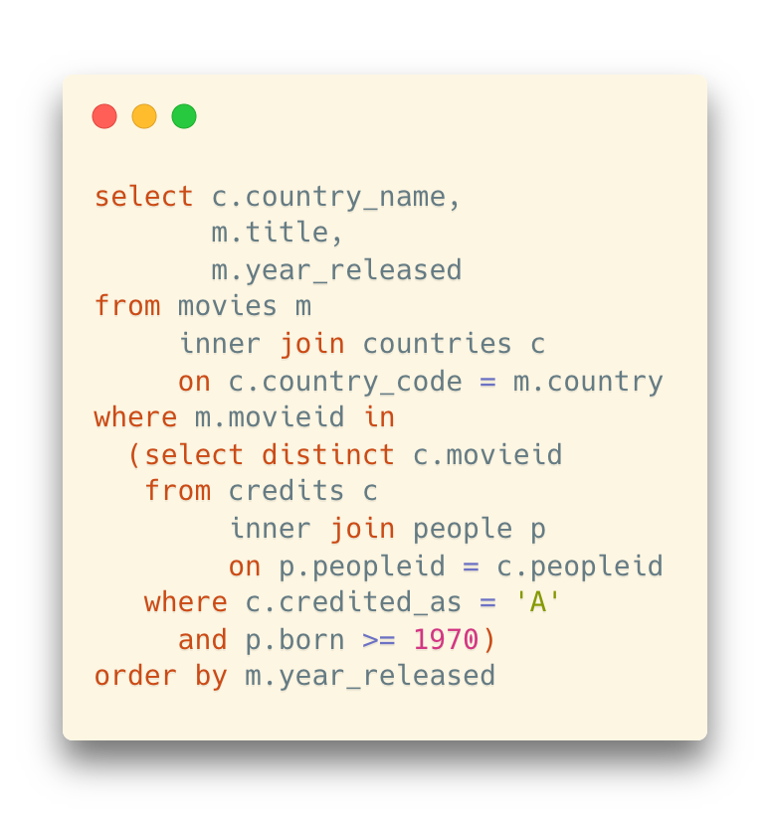
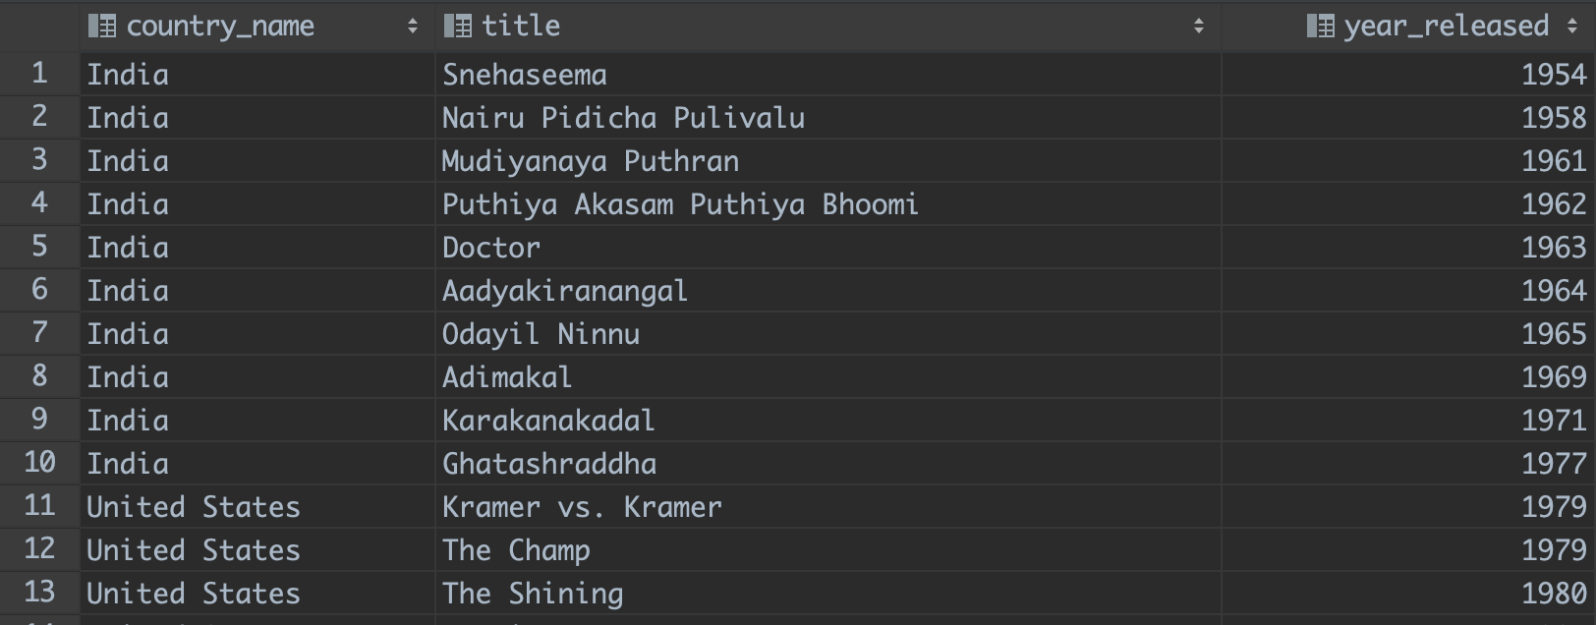
Ordering in SQL
Ordering with joins
We can sort by any column of any table in the join (remember the super wide table with all the columns from all tables involved)

Slide 10
Ordering in SQL
Ordering with joins
We can sort by any column of any table in the join (remember the super wide table with all the columns from all tables involved)

Slide 11
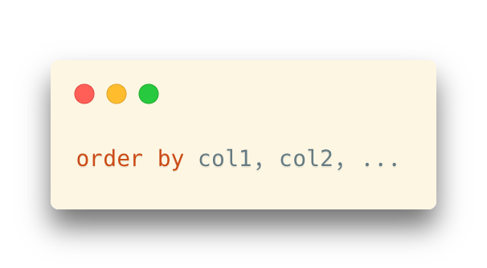
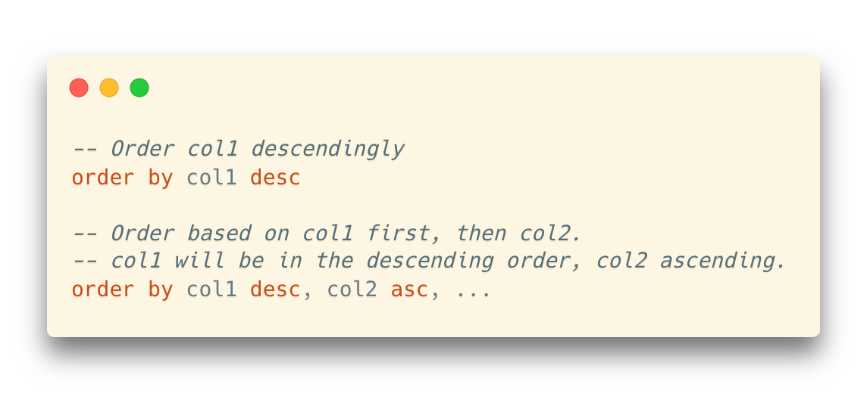
Advanced Ordering
Multiple columns
For example:
The result set will be order by col1 first
If there are rows with the same value on col1, these rows will be ordered by col2.
Ascending or descending order
Add desc or asc after the column
However, asc is the default option and thus always omitted

Slide 12
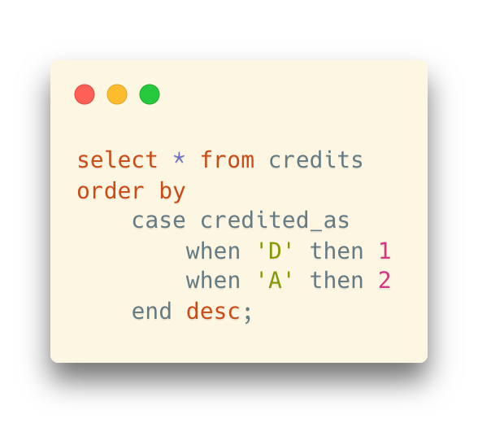
Advanced Ordering
Self-defined ordering
Use “case … when” in order by to define criteria on how to order the rows

Slide 13
Data Types in Ordering
Ordering depends on the data type
Strings: alphabetically,
Numbers: numerically
Dates and times: chronologically

Slide 14






Data Types in Ordering
What about NULL?
It is implementation-dependent
SQL Server, MySQL and SQLite:
“nothing” is smaller than everything
Oracle and PostgreSQL:
“nothing” is greater than anything
null
null

Slide 15
Ordering in Text Data
Remember, we have many different languages other than English
“Alphabetical order” in different languages means different things
Mandarin: Pinyin? Number of strokes?
Swedish and German
“ö” is considered the last letter in Swedish, while in German it is ordered after “o”.

Slide 16
Self Study: Text Encoding
Key Question: How does characters represented in a computer?
Wikipedia – Character encoding: https://en.wikipedia.org/wiki/Character_encoding
A video on Bilibili: https://www.bilibili.com/video/BV1xP4y1J7CS

Slide 17
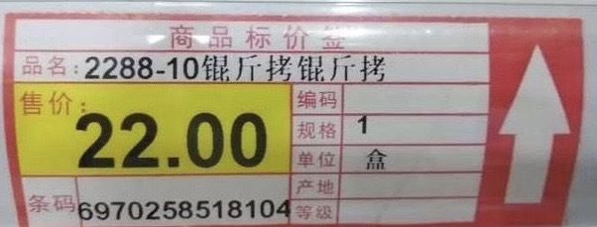

Self Study: Text Encoding
Try to answer the following questions:
What are ASCII, Unicode, UTF-8, and UTF-16? What are the relationships between them?
What are GB2312, GB18030, and GBK? What are “锟斤拷” and “烫烫烫”? How can you make it (not) happen?
Given a string with several characters, can you print the bitmap of this string?
Are emojis characters? How can you insert an emoji in a text editor?
What are the default character encodings in different platforms?
OS: Windows, MacOS, Linux
DBMS: PostgreSQL, etc.
Programming Languages: Java, C, C++, Python, etc.
How can we translate strings from one encoding to another?
E.g., with text editors (Windows Notepad, VSCode, Sublime Text, etc.); in programming languages; in DBMS

Slide 18
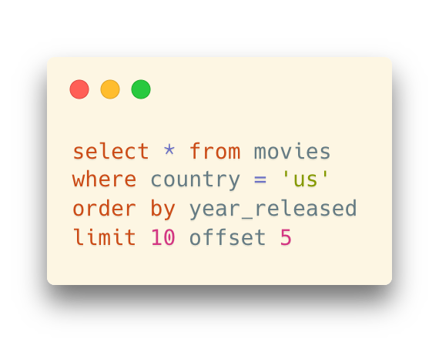
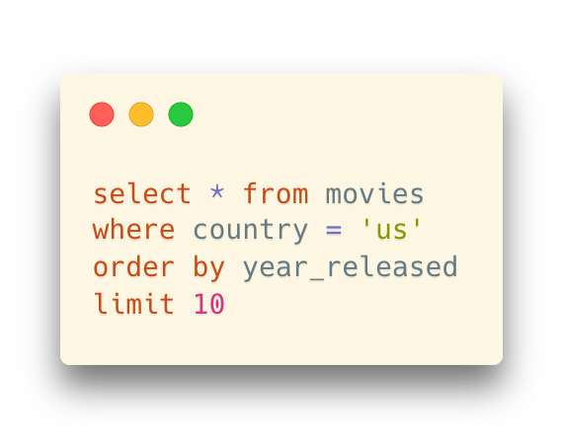
Limit and Offset
Get a slice of the long query result
limit k offset p
Return the top-k rows in the result set and skip the first p rows
offset is optional (which means “offset 0”)
Always used together with order by
E.g., get the top-k query results under a certain ordering criteria
* In some DBMS, the syntax can be different
Always refer to the software manual for specific features

Slide 19
Window Function

Slide 20
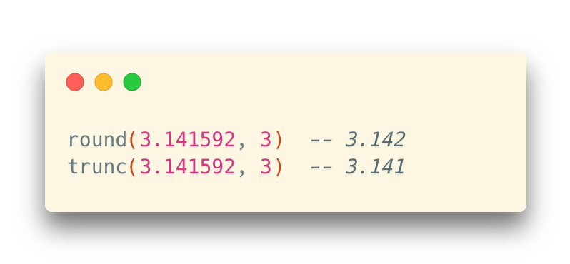
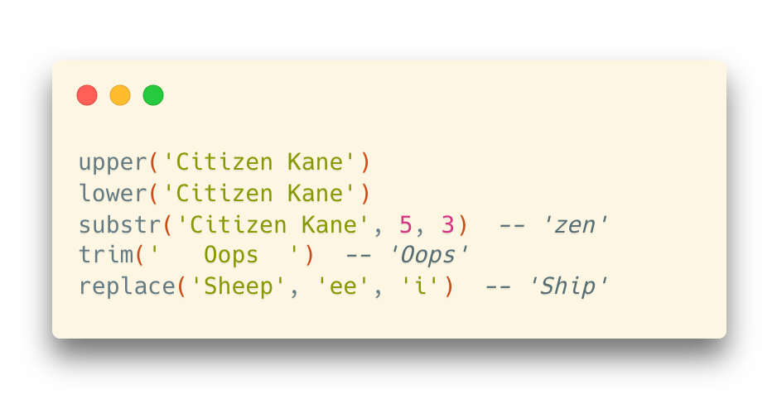
Scalar Functions and Aggregation Functions
Scalar function
Functions that operate on values in the current row
Recall: “Some Functions”, Lecture 3
Aggregation function
Functions that operate on sets of rows and return an aggregated value
Recall: “Aggregate Functions”, Lecture 4

Slide 21
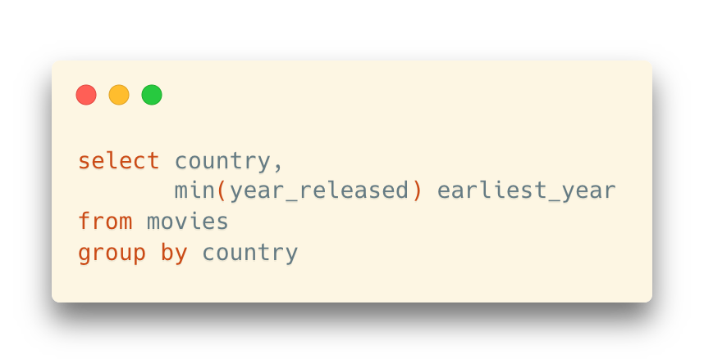
Issues with Aggregate Functions
A Problem: In aggregate functions, the details of the rows are vanished
For example: If we ask for the year of the oldest movie per country,
… we get a country, a year, and nothing else.

Slide 22
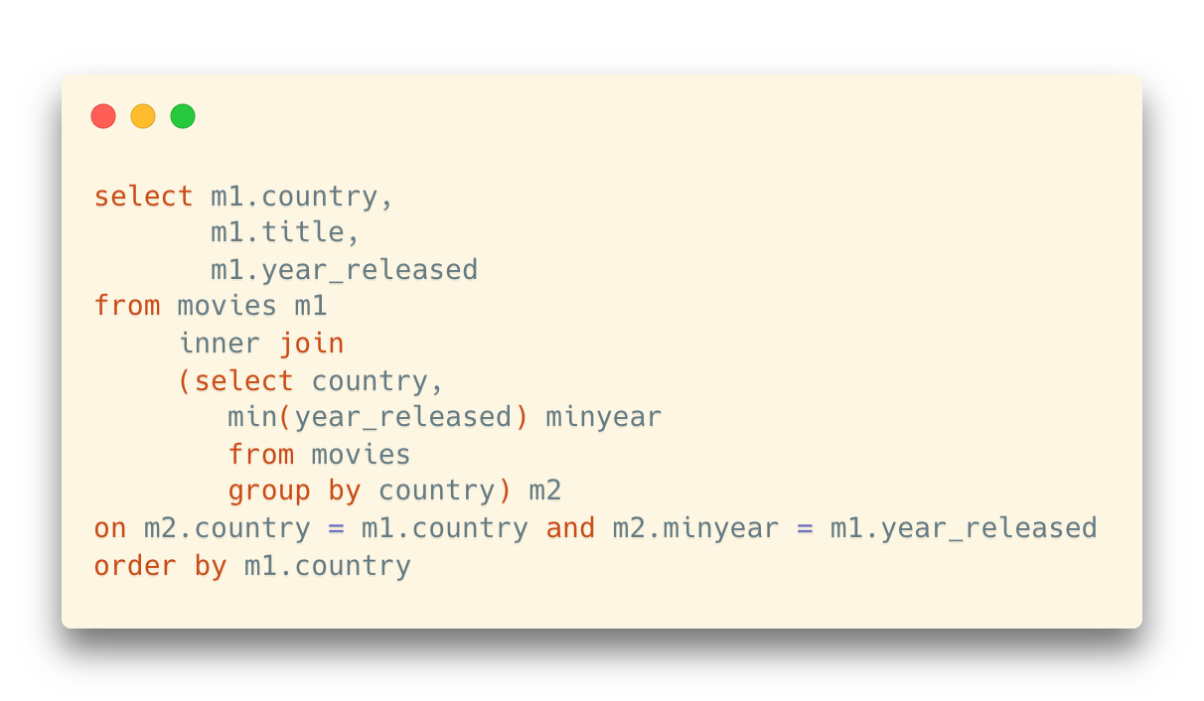
Issues with Aggregate Functions
A Problem: In aggregate functions, the details of the rows are vanished
For example: If we ask for the year of the oldest movie per country,
… we get a country, a year, and nothing else.
If we want some more details, like the title of the oldest movies for each country, we can only use self-join to keep the columns

Slide 23
Issues with Aggregate Functions
A Problem: In aggregate functions, the details of the rows are vanished
Another example: How can we rank the movies in each country separately based on the released year?
“order by” for subgroups
One more example: Get the top-3 oldest movies for each country.
How can we implement it?

Slide 24
Window Function
Syntax:
<function> over (partition by <col_p> order by <col_o1, col_o2, …>)
<function>: we can apply (1) ranking window functions, or (2) aggregation functions
partition by: specify the column for grouping
order by: specify the column(s) for ordering in each group

Slide 25
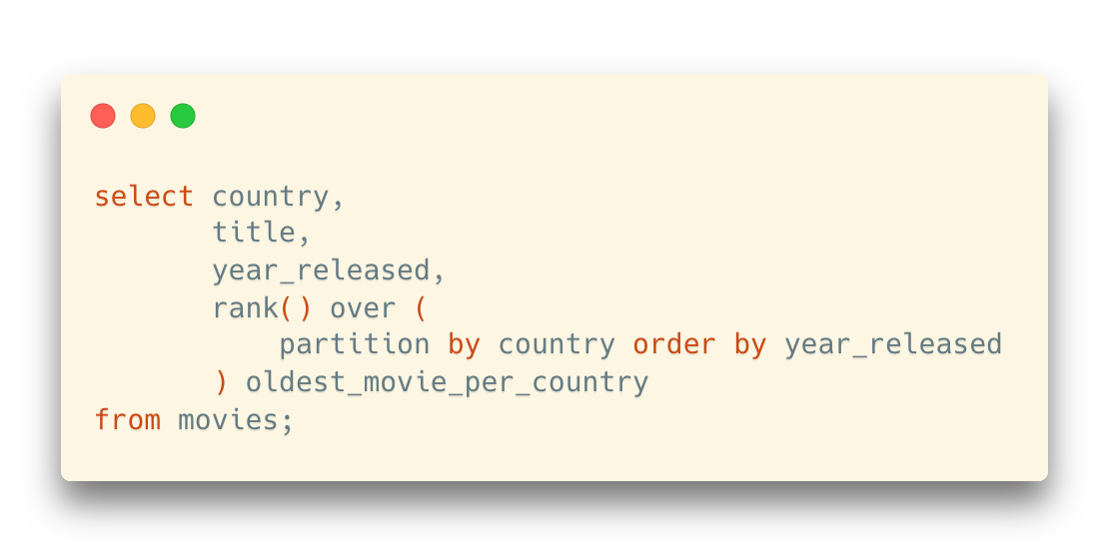
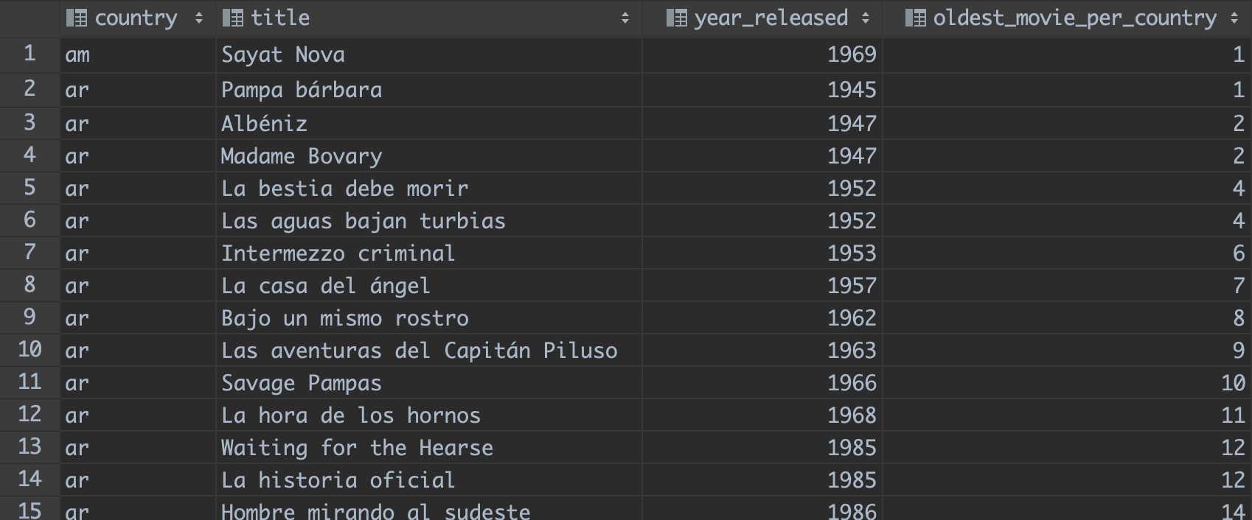
Ranking Window Function
Example
How can we rank the movies in each country separately based on the released year?
“order by” for subgroups

Slide 26
Ranking Window Function
Example
How can we rank the movies in each country separately based on the released year?
“order by” for subgroups
country | title | year_released | oldest_movie_per_country
ar | some title | 1948 | 1
ar | some title | 1959 | 2
ar | some title | 1980 | 3
cn | some title | 1987 | 1
cn | some title | 2002 | 2
uk | some title | 1985 | 1
uk | some title | 1992 | 2
uk | some title | 2010 | 3
You can also add “desc” here, similar to the “order by” we introduced before
partition by country
the selected rows will be grouped (partitioned) according to the values in the column country
rank()
A function to say that “I want to order the rows in each partition”
No parameters in the parentheses
order by year_released
In each group (partition), the rows will be ordered by the column “year_released”

Slide 27
Ranking Window Function
Example
How can we rank the movies in each country separately based on the released year?
“order by” for subgroups
country | title | year_released | oldest_movie_per_country
ar | some title | 1948 | 1
ar | some title | 1959 | 2
ar | some title | 1980 | 3
cn | some title | 1987 | 1
cn | some title | 2002 | 2
uk | some title | 1985 | 1
uk | some title | 1992 | 2
uk | some title | 2010 | 3
Note: partition functions can only be used in the select clause
… since it is designed to work on the query result

Slide 28
Ranking Window Function
Example
How can we rank the movies in each country separately based on the released year?
“order by” for subgroups
country | title | year_released | oldest_movie_per_country
ar | some title | 1948 | 1
ar | some title | 1959 | 2
ar | some title | 1980 | 3
cn | some title | 1987 | 1
cn | some title | 2002 | 2
uk | some title | 1985 | 1
uk | some title | 1992 | 2
uk | some title | 2010 | 3
Partitioned by country
i.e., a country in a group
An order value is computed for each row in a partition.
Only inside the partition, not across the entire result set

Slide 29
Ranking Window Function
Why window function, not group by?
“Group by” reduces the rows in a group (partition) into one result, which is the meaning of “aggregation”
Then, the values in non-aggregating columns are vanished
Window functions do not reduce the rows
Instead, they attach computed values next to the rows in a group (partition) and keep the details
Actually, the partition here means “window”: an affective range for statistics

Slide 30
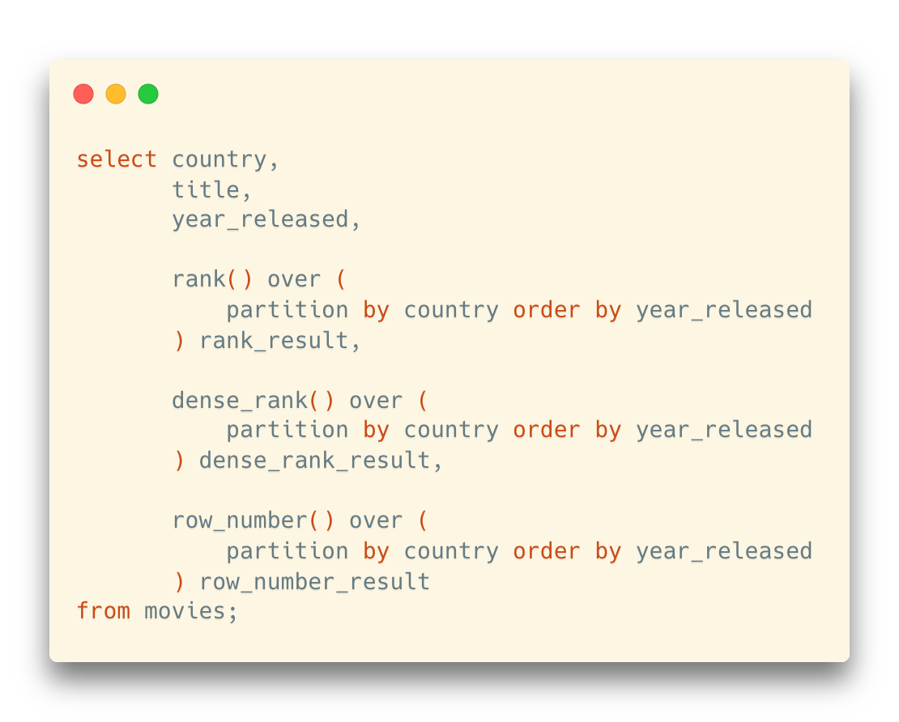
Ranking Window Function
Some more ranking window functions
Besides rank(), we also have dense_rank() and row_number()
The difference is about how they treat rows with the same rank
country | title | year_released | rank_result | dense_rank_result | row_number_result
cn | some title | 1948 | 1 | 1 | 1
cn | some title | 1959 | 2 | 2 | 2
cn | some title | 1959 | 2 | 2 | 3
cn | some title | 1987 | 4 | 3 | 4
cn | some title | 2002 | 5 | 4 | 5
uk | some title | 1985 | 1 | 1 | 1
uk | some title | 1992 | 2 | 2 | 2
uk | some title | 2010 | 3 | 3 | 3

Slide 31
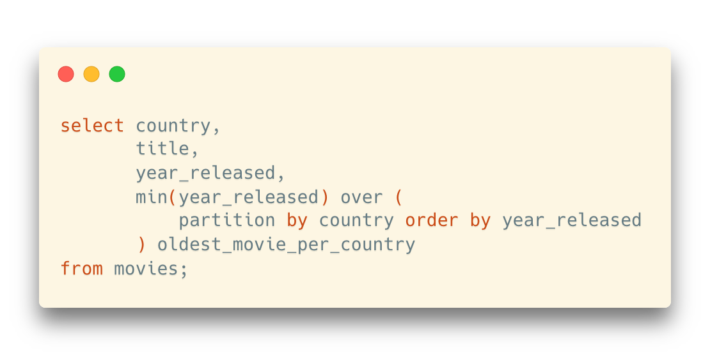
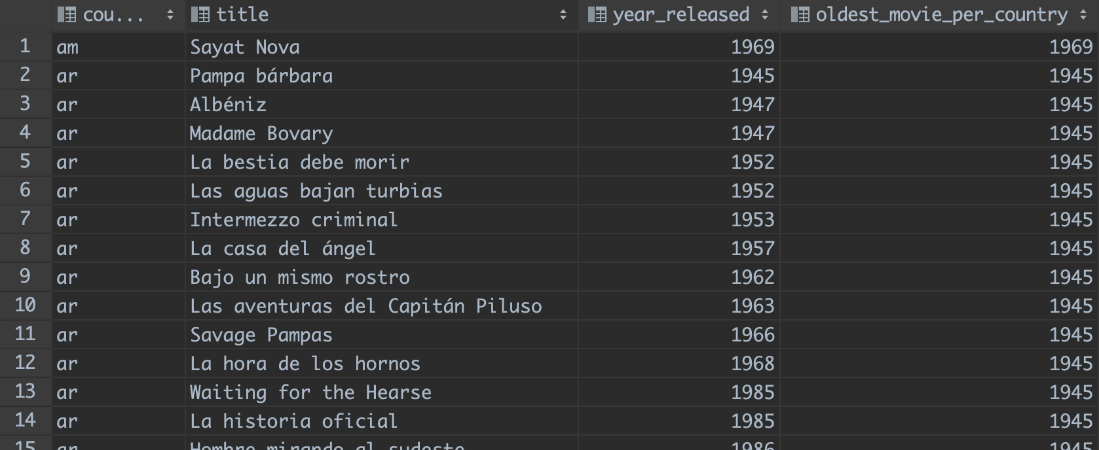
Aggregation Functions as Window Functions
max(col) and min(col)
Need to specify a column in the parameter list
The min/max value for each partition is assigned for all the rows inside this partition

Slide 32
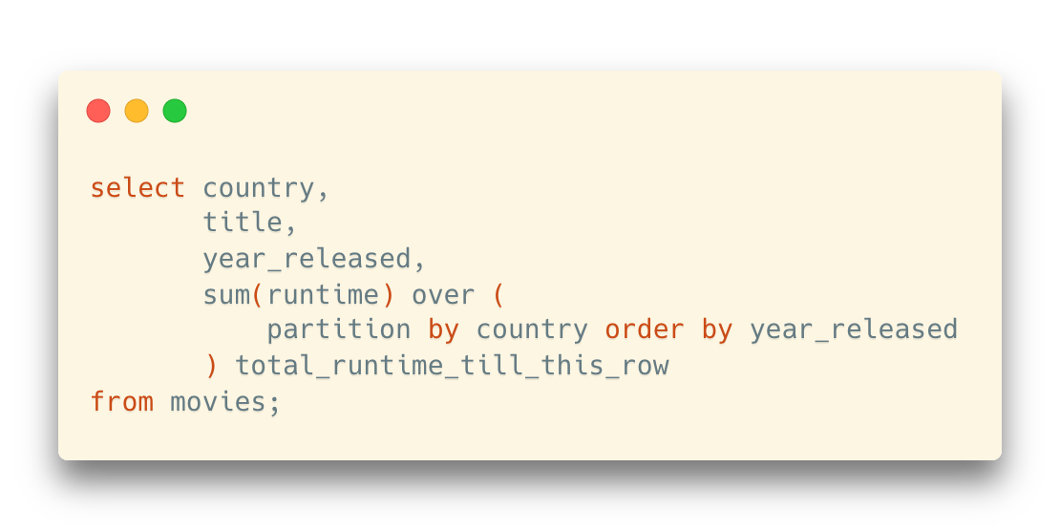
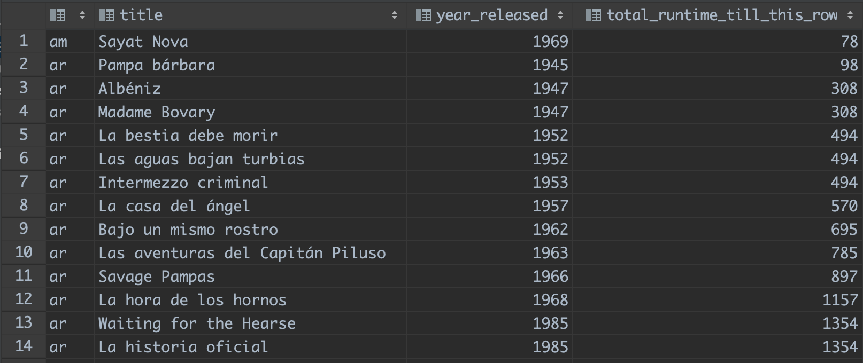
Aggregation Functions as Window Functions
sum(col), count(col), avg(col), stddev(col), etc.
Different from min/max: for these aggregation functions, it means the aggregation value from the first row to the current row in its partition when order by is specified
However, if there is no order by, the behavior will be similar to min() and max()
One result for all rows
Pay attention to the behavior on rows with the same rank:
They are “treated like the same row” here

Slide 33
Exercise
Question: How can we get the top-5 most recent movies for each country?
Hint: Use a subquery in the “from” clause

Slide 34
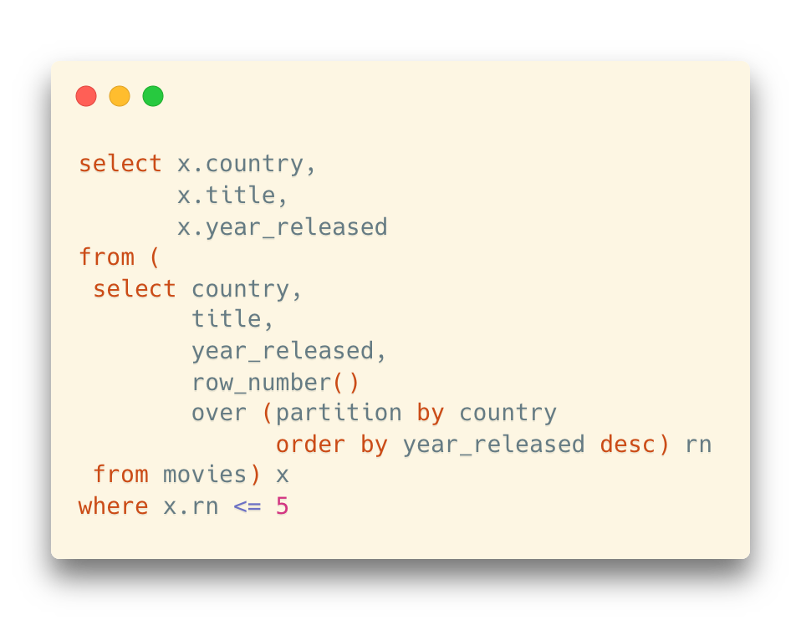
Exercise
Question: How can we get the top-5 most recent movies for each country?
Hint: Use a subquery in the “from” clause

Slide 35
Function

Slide 36
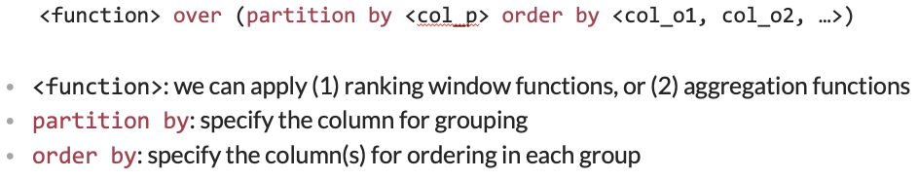
Built-in Functions
Most DBMS provides a series of built-in functions
E.g., Scalar function, aggregation function, window function

Slide 37
Self-defined Function
Sometimes the built-in functions cannot fulfill our requirements
And the power of declarative language (SQL) is not enough
Most DBMS implement a built-in, SQL-based programming language
A procedural extension to SQL

Slide 38
Procedural vs. Declarative
Two different programming paradigms
Imperative: Describe the algorithms step-by-step (命令式编程)
Procedural: C (and many other legacy languages)
Object-oriented: Java
Declarative: Describe the result without specifying the detailed steps (声明式编程)
(Pure) declarative: SQL, Regular Expressions, Markup (HTML, XML), CSS
Functional: Scheme, Haskell, Scala, Erlang
Logic programming: Prolog

Slide 39
Procedural vs. Declarative
E.g., How can we get a cup of tea?
In a procedural way:
In a declarative way:

Slide 40

Procedural vs. Declarative
E.g., How can we get a cup of tea?
In a procedural way:
In a declarative way:
1. Get a cup
2. Get some tea
3. Get some hot water
4. Put tea into the cup
5. Pour hot water into the cup
6. return tea;

Slide 41

Procedural vs. Declarative
E.g., How can we get a cup of tea?
In a procedural way:
In a declarative way:
You don’t really need to know how to make a cup of tea
The system can do it in a black-box manner
1. Get a cup
2. Get some tea
3. Get some hot water
4. Put tea into the cup
5. Pour hot water into the cup
6. return tea;
<a cup of tea/>

Slide 42

Procedural vs. Declarative
E.g., Find all Chinese movies before 1990 in the movies table?
In a procedural way:
In a declarative way:
You don’t really need to know how to filter the table
The DBMS system can do it in a black-box manner
1. Read the movies table into the memory
2. For each row i in the table, repeat:
2.1 In row i, read the value of the column “country”
2.2 if …
select * from movies where country = ‘cn’ and year_released < 1990

Slide 43
Procedural vs. Declarative
Benefits in declarative languages
No need to understand the details
The systems take in charge of all the details
Easier to use than imperative programming
More user-friendly
Problem in declarative languages
Cannot specify the control flow of a program
“If there is no such command as <a cup of tea/>, you need to create it by yourself”

Slide 44
Procedural Extension to SQL
Many DBMS products provide a proprietary procedural extension to the standard SQL
Transact-SQL (T-SQL)
PL/SQL
PL/PGSQL
(No specific name)
(Not supported)
… well, sometimes SQLite is even not considered a DBMS

Slide 45
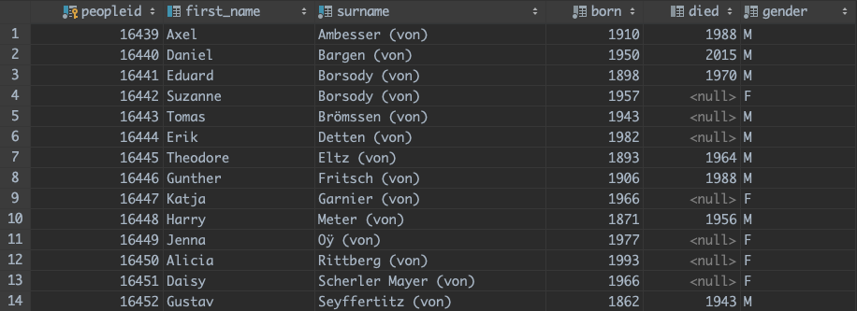
Function in (Postgre)SQL
Example: Display the full name for people with “von”
When introducing update, we have modified the names starting with “von” into “… (von)” for ordering

Slide 46
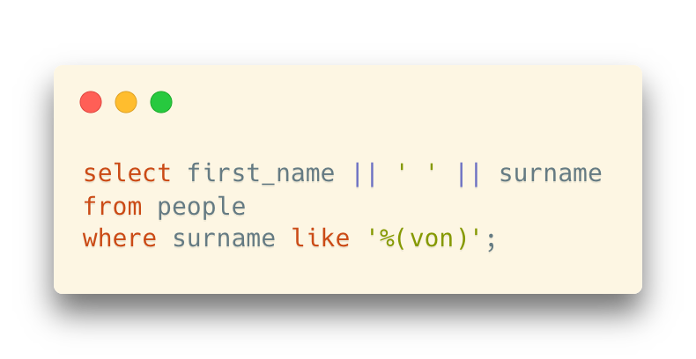
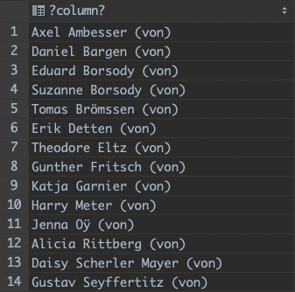
Function in (Postgre)SQL
If we simply concatenate the first name and the last name, it looks like this:
A little bit weird format (a trailing “von”)

Slide 47
Function in (Postgre)SQL
Question: How can we restore the format into “first_name von surname”?
String operations

Slide 48
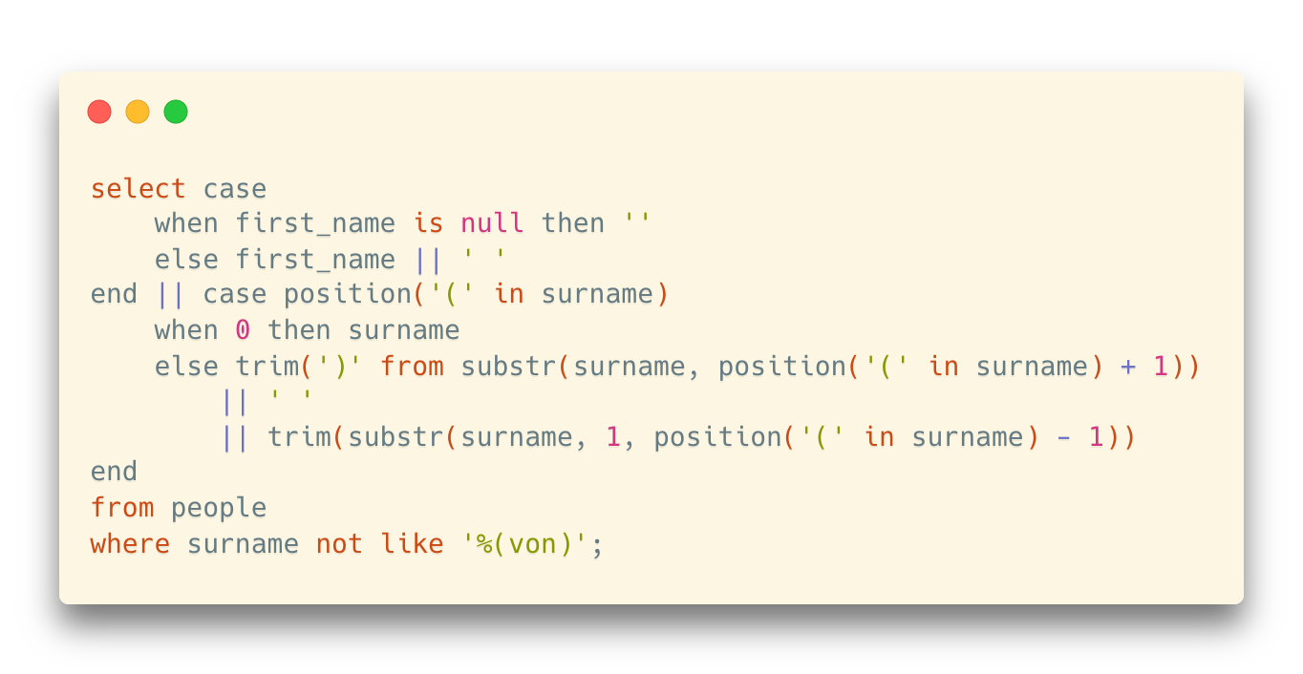
Function in (Postgre)SQL
Question: How can we restore the format into “first_name von surname”?
String operations

Slide 49
Function in (Postgre)SQL
Question: How can we restore the format into “first_name von surname”?
String operations
Then, how can we store this part to reuse it in the future?

Slide 50
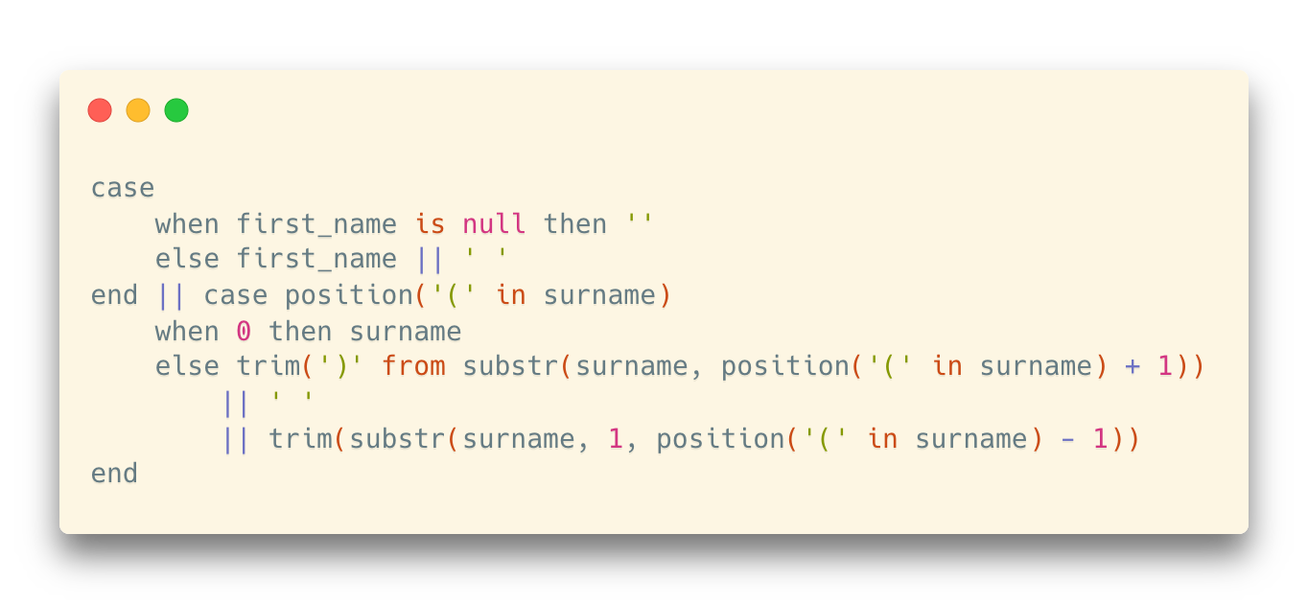

Function in (Postgre)SQL
“Copy and paste” is not a good habit
Whenever you have painfully written something as complicated, which is pretty generic, you'd rather not copy and paste the code every time you need it

Slide 51
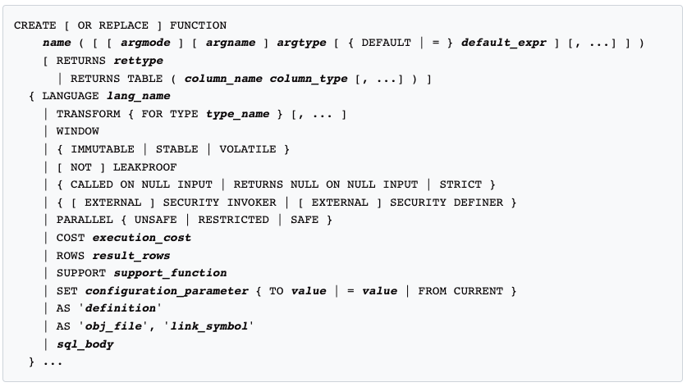
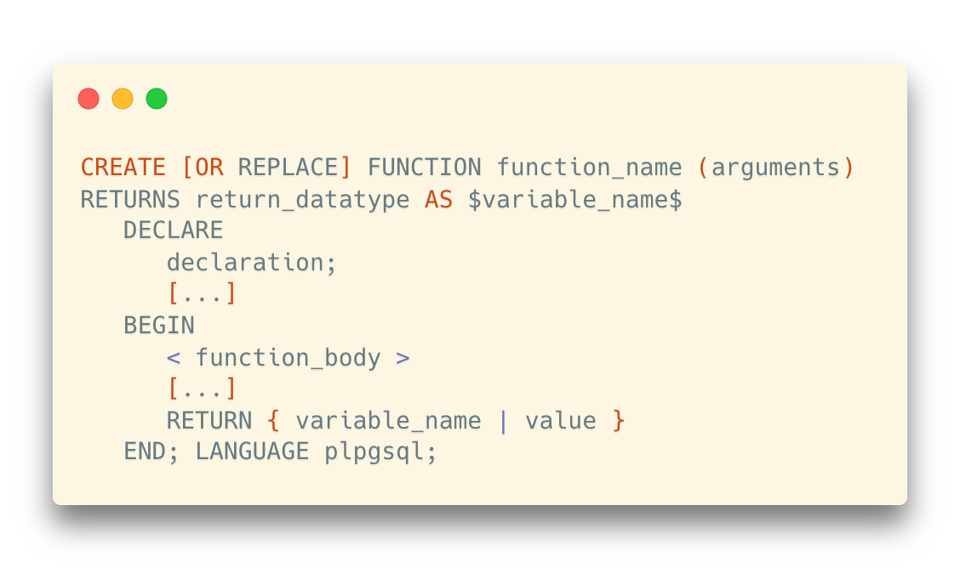
Function in (Postgre)SQL
Store for Reuse
In PostgreSQL, we can store the expression and reuse it in another context
Self-defined Function
create function
…or, a simpler version
https://www.postgresql.org/docs/current/sql-createfunction.html

Slide 52
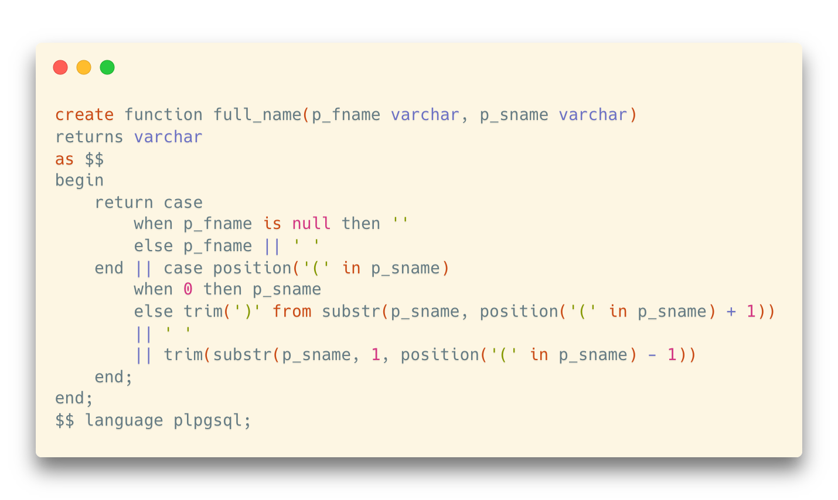
Function in (Postgre)SQL
How do we rewrite the name conversion expression into a function?

Slide 53
Function in (Postgre)SQL
How do we rewrite the name conversion expression into a function?
Function name and the parameter list
Format for variables and parameters: [name] [type]

Slide 54
Function in (Postgre)SQL
How do we rewrite the name conversion expression into a function?
Return type

Slide 55
Function in (Postgre)SQL
How do we rewrite the name conversion expression into a function?
Body

Slide 56
Function in (Postgre)SQL
How do we rewrite the name conversion expression into a function?
A very simple body: return the value of an expression

Slide 57
Function in (Postgre)SQL
How do we rewrite the name conversion expression into a function?
A very simple body: return the value of an expression
Procedural extensions provide all the bells and whistles in a true (procedural) programming languages, such as:
Variables
Conditions
Loops
Arrays
Error management
…

Slide 58
Function in (Postgre)SQL
How do we rewrite the name conversion expression into a function?
Language Type
PostgreSQL supports 4 procedural languages:
PL/pgSQL, PL/Tcl, PL/Perl, and PL/Python
Tcl, Perl, and Python are famous scripting languages in case you don’t know

Slide 59
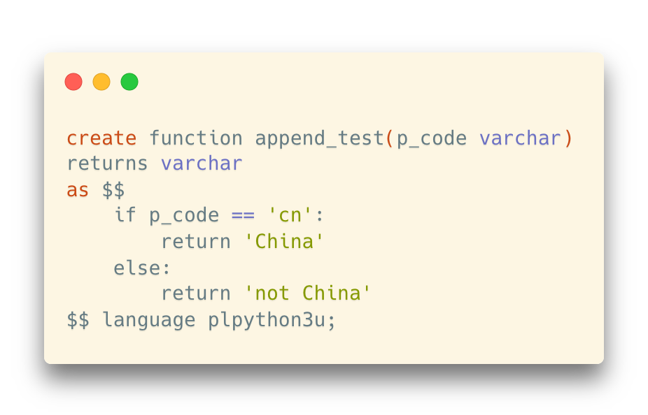
Function in (Postgre)SQL
How do we rewrite the name conversion expression into a function?
Yes, we can even use Python to write functions
Language Type
PostgreSQL supports 4 procedural languages:
PL/pgSQL, PL/Tcl, PL/Perl, and PL/Python
Tcl, Perl, and Python are famous scripting languages in case you don’t know

Slide 60
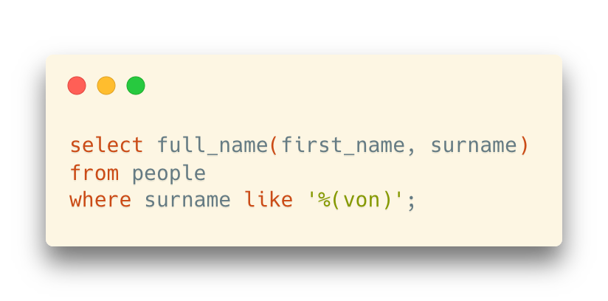
Function in (Postgre)SQL
Once your function is created, you can use it as if it were any built-in function.

Slide 61
Function in (Postgre)SQL
We can run select queries in functions
Example: design a function “get_country_name” to transform the country codes into country names based on the countries table

Slide 62
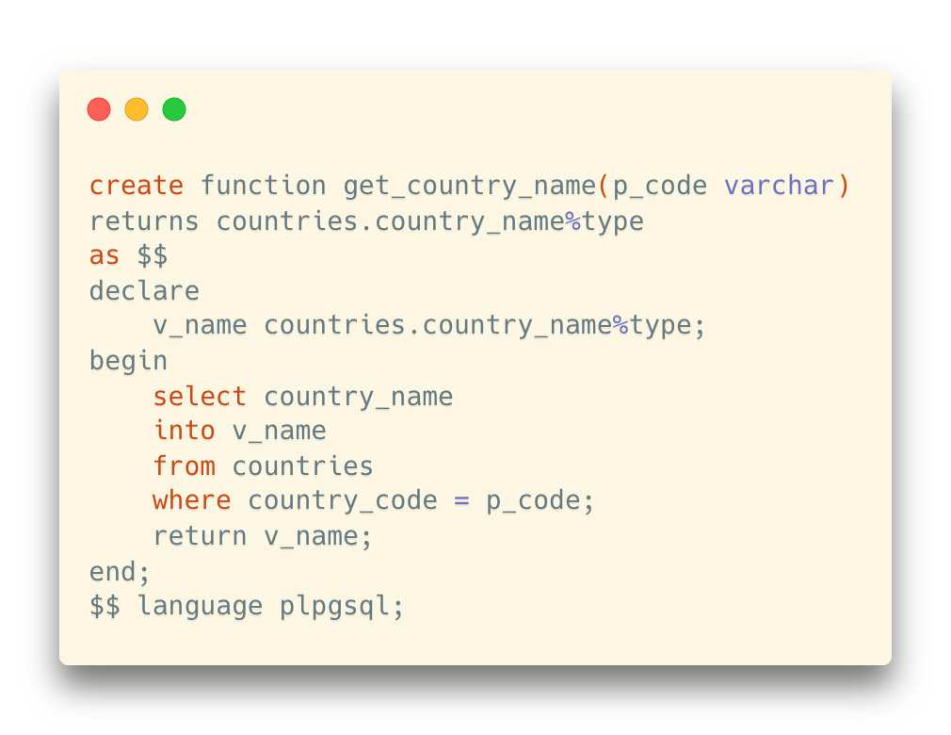
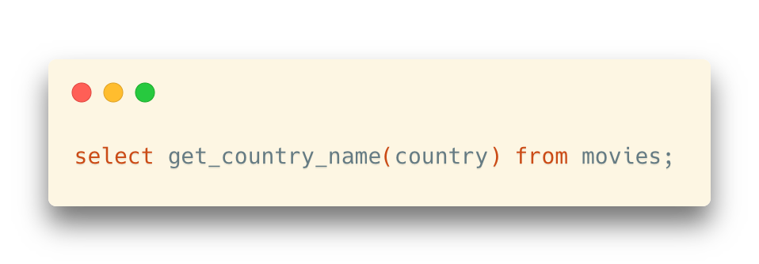
Function in (Postgre)SQL
We can run select queries in functions
Example: design a function “get_country_name” to transform the country codes into country names based on the countries table

Slide 63
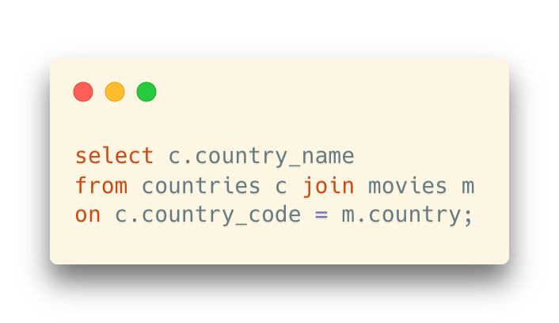
Function in (Postgre)SQL
We can run select queries in functions
Example: design a function “get_country_name” to transform the country codes into country names based on the countries table
… seems to be an easy way to get rid of join operations?

Slide 64
Function in (Postgre)SQL
“Cultural Mismatch”
Here we have a problem, because there is a big cultural gap between the relational mindset and procedural processing.
A “look-up function” forces a “one row at a time” join which in most cases will be dreadful
For each row in movies, the select query in get_country_name() is executed once

Slide 65


Comment on Procedural SQL (PL/SQL)
Tom Kyte, who is a Senior Technology Architect at Oracle, says that his mantra is:
You should do it in a single SQL statement if at all possible.
If you cannot do it in a single SQL statement, then do it in PL/SQL (as little PL/SQL as possible!)
And some other suggestions (from your lecturer):
You should ask for help from someone more experienced than you
Stackoverflow, forums, Google, etc.

Slide 66
More to Read
We may not cover all the details in functions in the theoretical session, so here are some more materials on procedural programming in PostgreSQL:
Lab tutorial on Functions
Please read it before your next lab sessions
Chapter 5.2 “Functions and Procedures,” Database System Concepts (7th Edition)
Chapter 43 “PL/pgSQL,” PostgreSQL Documentation
https://www.postgresql.org/docs/current/plpgsql.html

